Slide 1
NEW TEACHER INDUCTION PROGRAMME
SOUTH AFRICAN PRINCIPAL ASSOCIATION - SAPA

Slide 2
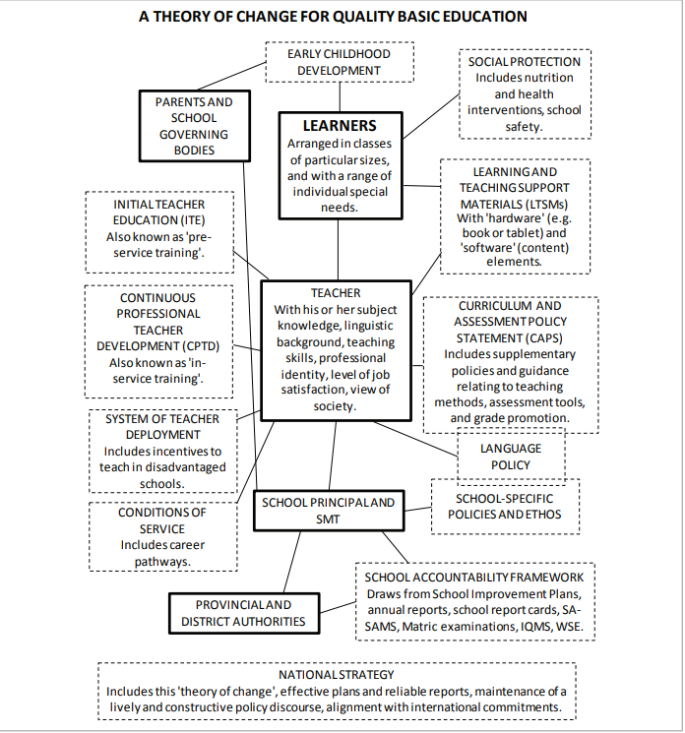
Source: DBE Strategic Plan 2021-24

Slide 3
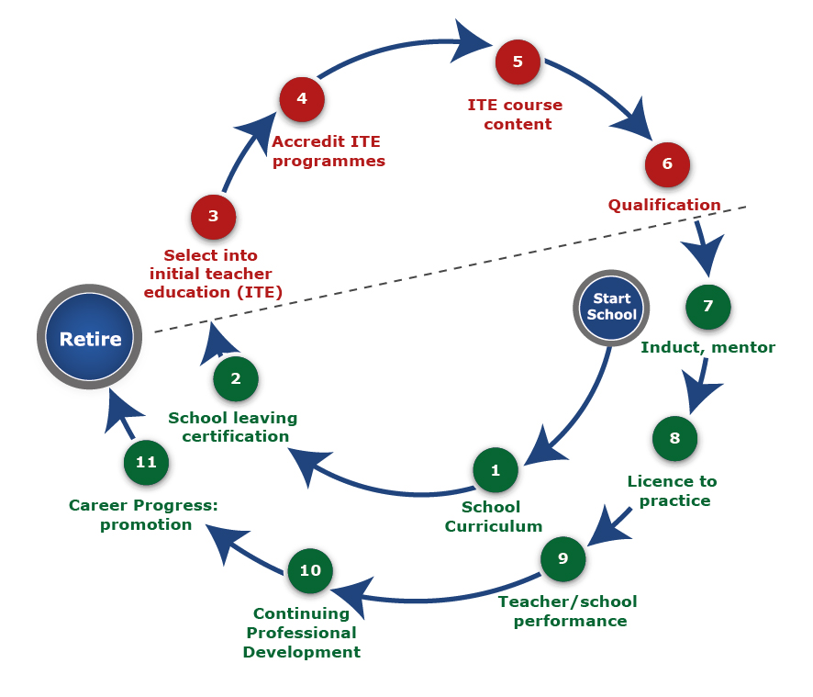
TEACHER EDUCATION AND TEACHING
Source: Dr N Taylor, JET Education Services

Slide 4
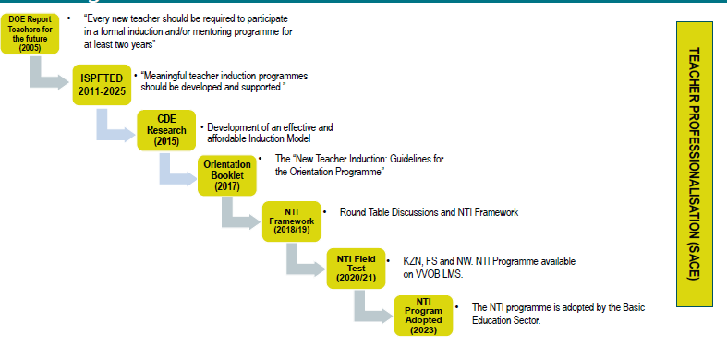
Roadmap for NTIP

Slide 5
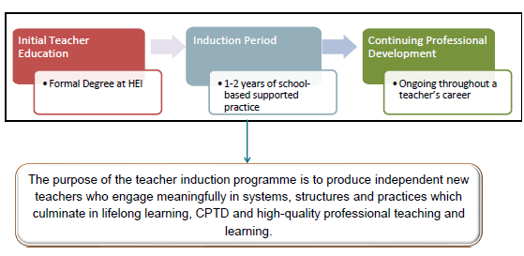
NTIP - RSA MODEL

Slide 6
RSA MODEL FOR NEW TEACHER INDUCTION
MENTOSHIP
PLC
PDP
TRAINING CPD
How to select mentors, how to support mentors
Province to build database of mentors
Mentors Incentives (not monetary)
Who may be a mentor
Encouraging teachers to form own PLCs
Encourage Teachers to belong to PLCs
Support PLCs with information and knowledge content
Support PLCs for their functionality
First task o f every teacher, to develop Professional Development Plan
Evaluate the plan regularly
Hold yourself accountable to the plan
Teachers are Life-long learners hence they need on continuous basis

Slide 7



Policy documents supporting the NTIP
ISPFTED -2011-2025- “Meaningful teacher induction programmes should be developed and supported.”
PAM- Act 16 provisions of leave for personal & professional development

Slide 8
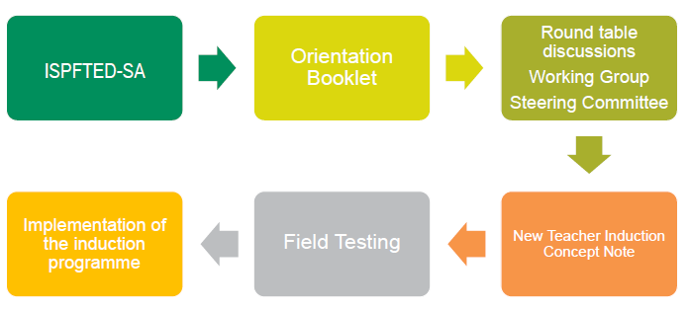
POLICIES THAT INFORM
NEW TEACHER INDUCTION
ISPFTED -2011-2025- “Meaningful teacher induction programmes should be developed and supported.”
PAM- Act 16 provisions of leave for personal & professional development

Slide 9
Who is NTIP targeting
graduates who have completed their professional qualifications (at REQV 14) at higher education institutions who will be appointed at a South African public school for the first time; or
foreign teachers who are new to the profession; or
foreign teachers who have served as teachers in their country of origin; or
South Africans who have obtained their teaching qualifications in other countries; or
teachers who are returning to the profession after not having taught for five years or more

Slide 10
WHY NEW TEACHER INDUCTION
NTIP can assist new teachers improve practice, learn professional responsibilities and ultimately positively affect student learning and improve learning outcomes.
improving the quality of education (teaching and learning)
To provide support to the new teachers in their new roles in schools
To assist teachers in adapting to a new workplace culture.
To assist new teachers to in understanding students, classroom management and curriculum
Information about the systems and processes that guide the workplace, as well as school norms, are integral for teachers to settle in and feel confident; however, it's important to keep in mind the pace at which this is done.
NTI takes into account the school environment and the highest priority needs of new teachers.
spacing out conversations around systems, collaborative planning, curriculum, teaching and learning, and assessment over the year is prudent.
conversations are planned around a coinciding event or issue, understanding deepens.

Slide 11
NTIP STAKEHOLDERS
New Teacher (Induction and Mentoring)
DBE
DHET
HEI
VVOB
SACE
JET
NGOs
Teacher Unions

Slide 12
RESPONSIBILITIES FOR SUPPORTING THE NEW TEACHER INDUCTION
DBE
Province
District
Subject Advisors
Circuit
School
SGB
SMT
School Principal
Head of Department
Peers
SACE
Teacher Unions
NGOs

Slide 13
Provide Policy/Framework/Guidelines for the implementation of NTIP
National Management Plan for Provincial Engagement
Support and Monitoring implementation
Monitoring tool design
Collect national data on new teachers employed
Collect national data on trained mentors in the sector
Gather data on the implementation of NTIP
Advocacy of NTIP through social media etc
Streamline communication on NTIP
DEPARTMENT OF BASIC EDUCATION

Slide 14
PROVINCIAL EDUCATION DEPARTMENT
Draft the PED management plan with timeframes and targets
Appoint a PED steering committee (PED Director, District Officials, SACE any other partner/stakeholder/s)
Provide guidance to district in the implementation of NTIP
Mediate the NTIP material – districts, circuits and schools
Working with Districts, identify teachers that may serve as mentor teachers
Collect data of new teachers in the provinces
Collect data of the trained mentors in the province
Advocate NTIP in the province
Monitor and support districts in the implementation of NTIP
Customise NTIP the school monitoring tools for reporting purpose by PED
Overseeing the implementation and REPORT on the New Teacher Induction Programme

Slide 15
Identify selected schools for phase-in implementation
Collect data of the new teachers in the District
Collect data of the trained mentors
Assist in identifying teachers that qualify as mentors for the district
Implement the NTIP in selected schools
Monitor and support implementation of NTIP
On their routine monthly monitoring of schools (Add one of two questions on NTIP)
DISTRICTS

Slide 16
Responsible for professional management, leadership as well as development as outlined in PAM
Report to the circuit manager about the newly appointed teachers – identify newly qualified teachers from the teachers that arrived
Classify the new teachers– as per transfer, newly qualified
Explain the purpose of NTIP to the school principals
Assign or allocate a mentor to new qualified teacher/s provide support to the whole process.
Ensures that appointed teachers are vetted
Ensures that new teachers accessed DBE-VVOB material for NTIP
Provide continuous support for both mentors and mentees
Ensures that new teachers accessed DBE-VVOB material for NTIP
Provide orientation to the newly qualified teachers and newly appointed teachers (school ethos, culture, rules, official hours, etc)
PRINCIPAL

Slide 17
Allocate Time with the Mentee/ Newly employed Teacher
Deals with timetabling and ensure that there are dedicated hours for mentorship
Responsible for guiding New Teacjer on subject specific issues
Ensures that the mentor-mentee sessions are embedded in the daily school-work (including time allocation)
Provide support for PLC and LINK new teachers together or with support schools
Monitor activities of mentees
DEPARTMENTAL HEAD or MENTOR

Slide 18
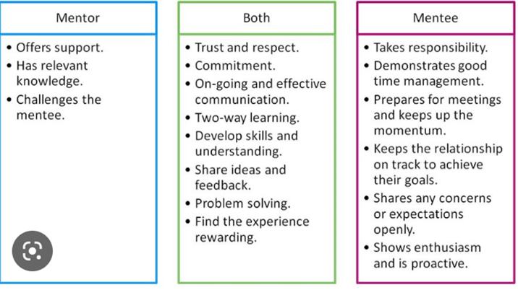
Mentoring Relationship

Slide 19
KEY ACTIVITIES FOR NTIP
NO | ACTIVITIES | FREQUENCY | RESPONSIBILITY
1. | Orientation workshop of mentees | Twice per year (1st Semester & 2nd Semester) | Province & Districts & Circuits & Schools Principals
2 | Orientation workshop for officials at District, circuit & Schools Principals | Annually & then only newly appointed Officials in second semester (August) | Province & Districts & Circuits
3 | Mentor Training workshop | Annually once- second semester for newly appointed mentors | Province & District
4. | Receiving New Teachers and ensuring they are SACE registered | On arrival | Principal and Deputy Principal
5. | Orientation on school culture, school policies | Week one of arrival | Principal
6. | Assigning a mentor for each newly appointed teacher | On arrival | Principal
7. | Mentor- Mentee Meetings | Weekly / Monthly | Mentor and Mentee
8. | Classroom Observations | Once Per Term | Mentor and Principal
9. | Professional Development session | Monthly | Principal, SMT, PLC & District
10. | Support visits | Twice per annum | DBE, PEDs, District
11. | Progress Report | Quarterly | Mentor and Principal
12 | Annual review of the programme | End of Academic Quarter | Districts & Schools

Slide 20
NTIP Enrolment per on LSM per Province

Slide 21
No of activities attempted

Slide 22
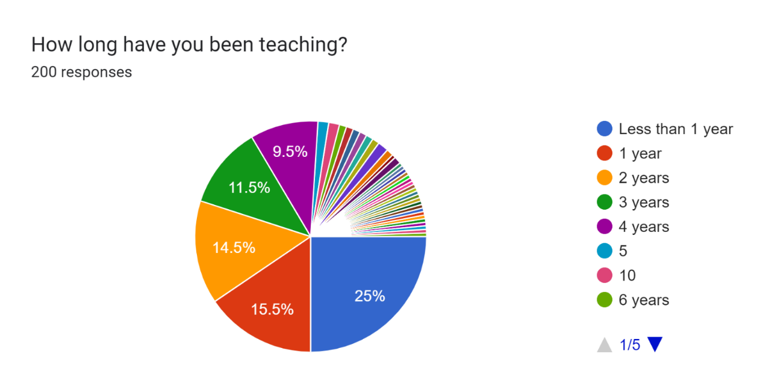
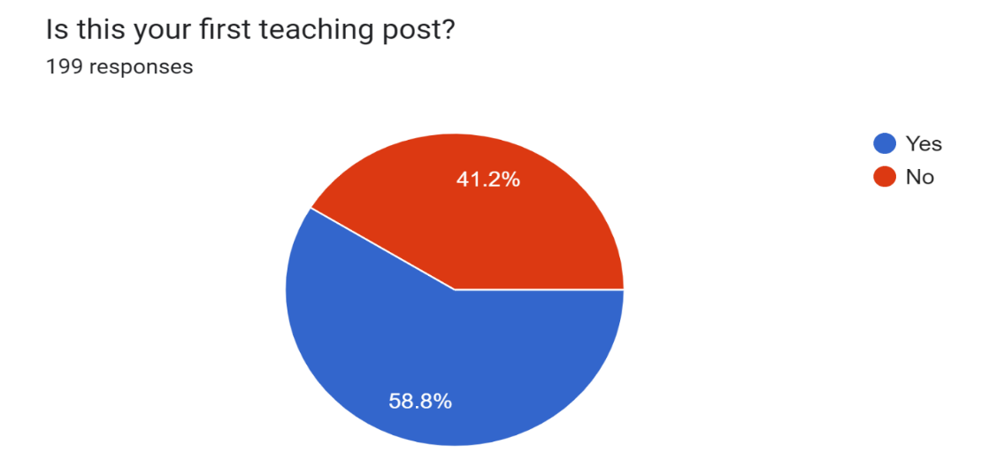
Teaching Experience
A survey was done on newly appointed teachers in 2024, and these are their response

Slide 23
NEW TEACHER INDUCTION PROGRAMME
The review’s recommendations: indicate that the model needs to be repackaged:
  support provided to inductees boosted their confidence and efficacy
  provides collaborative support and builds a support system for new teachers.
  new teachers gain knowledge and support, mentors develop leadership skills and derive satisfaction from being professionally valued
  provided substantial evidence for its expansion and statewide implementation for all beginning teachers
  network of support is in place, enabling teachers to be better prepared and supported, thus encouraging them to remain in the profession
  believed and hoped to achieve success even in schools with high needs
  Slide 25 – 43 are reflecting the current NTIP modules, for mentors and mentees
  The programme is currently under review and a policy on new teacher induction programme will be produced. The review process include consultation of all stakeholders – mainly school principals, mentors and newly qualified teachers.
  There was a stakeholder engagement where stakeholders were engaged in shaping the policy.
  SAPA is requested to provide written submissions for consideration as policy is written.

Slide 24
THEMES COVERED IN THE COURSE FOR MENTORS
Mentoring Expectations
Needs of beginning Teachers
Stages of beginning Teaching
Characteristics of a Mentors
Establishing a relationship
Classroom Observation
Reflective Practice and questioning
Actionable feedback

Slide 25
7 THEMES on the LMS
Teacher Professionalism
Communication
Inclusive Teaching and Learning
Curriculum, Pedagogy and Assessment
Resources
Teacher as a critical, reflective practitioner and researcher

Slide 26
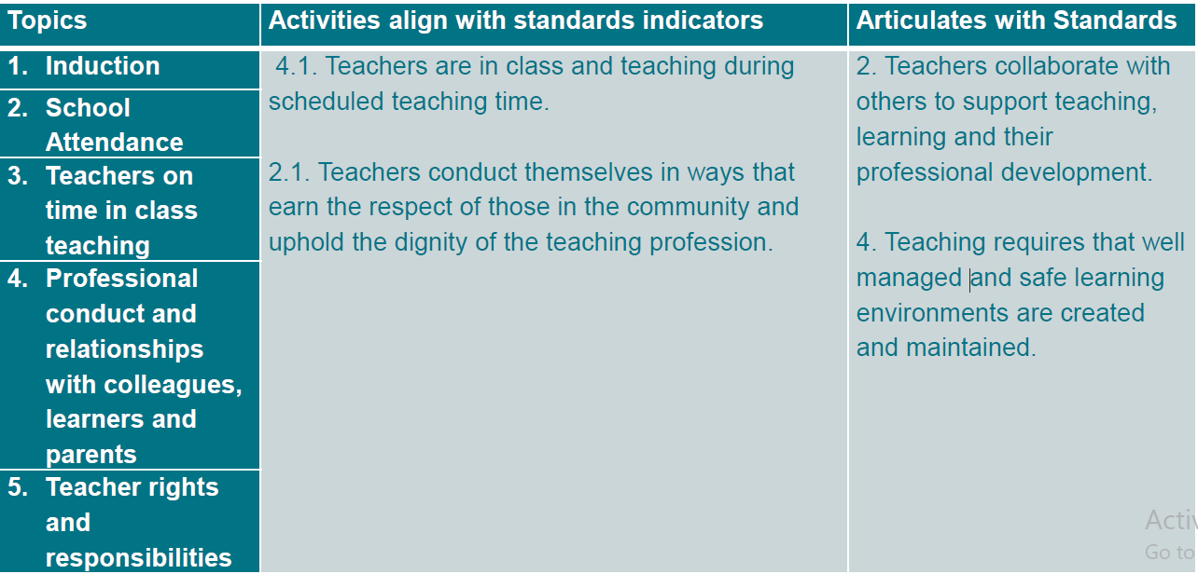
Theme One: Teacher Professionalism – PTS 1
VVOB presentation Slide 38 -47

Slide 27
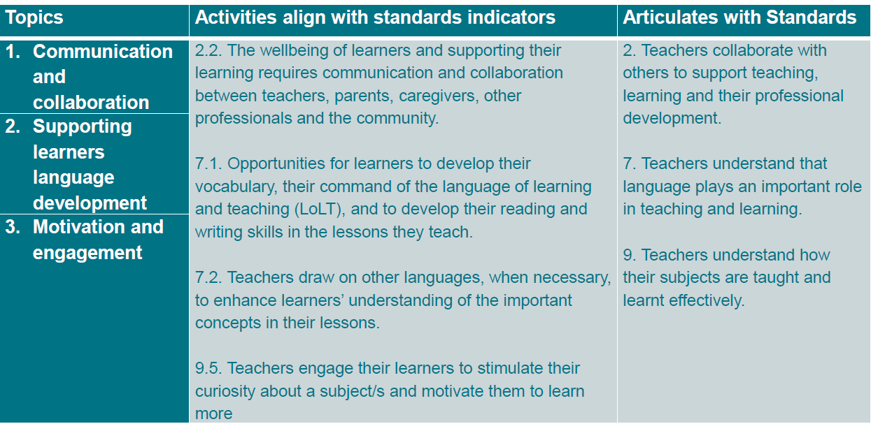
THEME TWO: COMMUNICATIONS – PTS 2

Slide 28
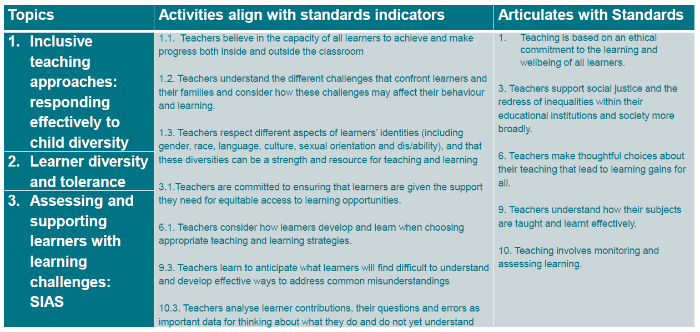
THEME THREE: INCLUSIVE TEACHING AND LEARNING – PTS 3

Slide 29
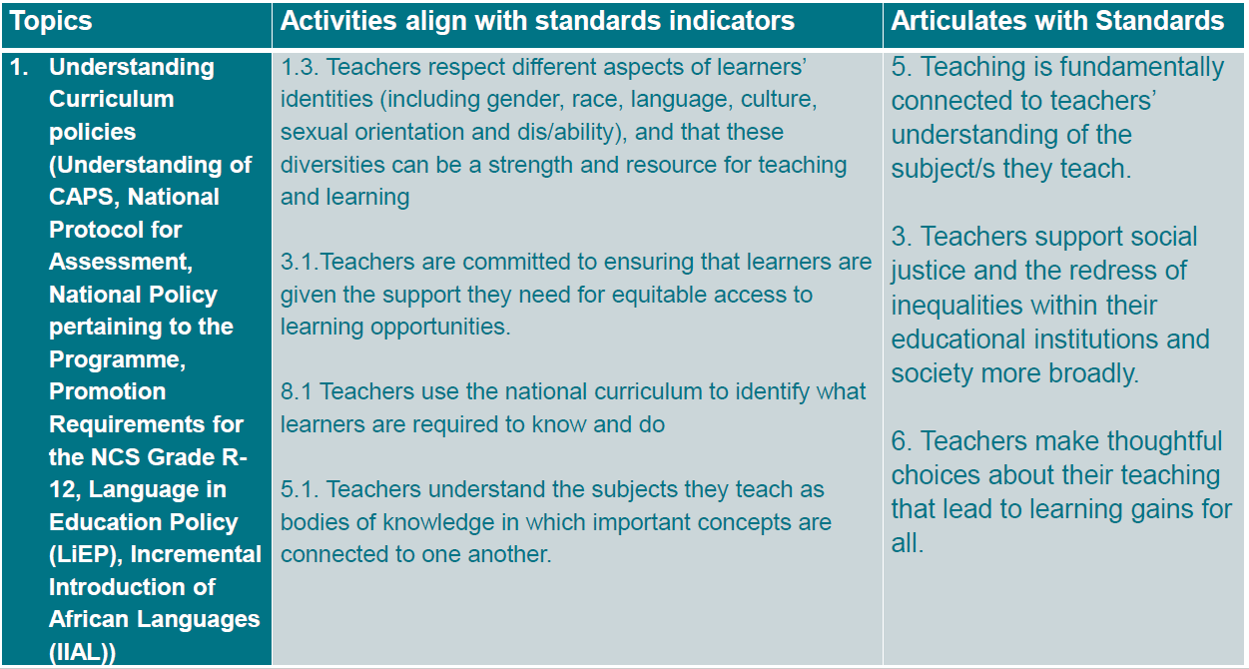
THEME FOUR: CURRICULUM PEDAGOGY AND ASSESSMENT – PTS 5, 8, 9, 10

Slide 30
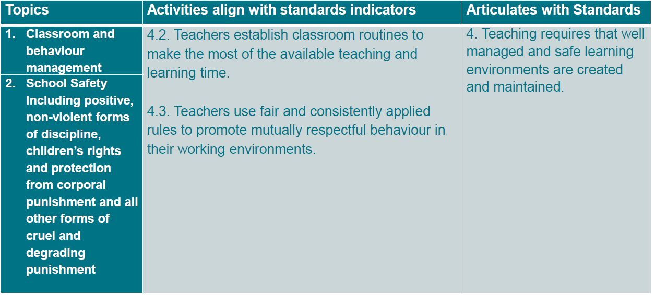
THEME FIVE: CLASSROOM MANAGEMENT

Slide 31
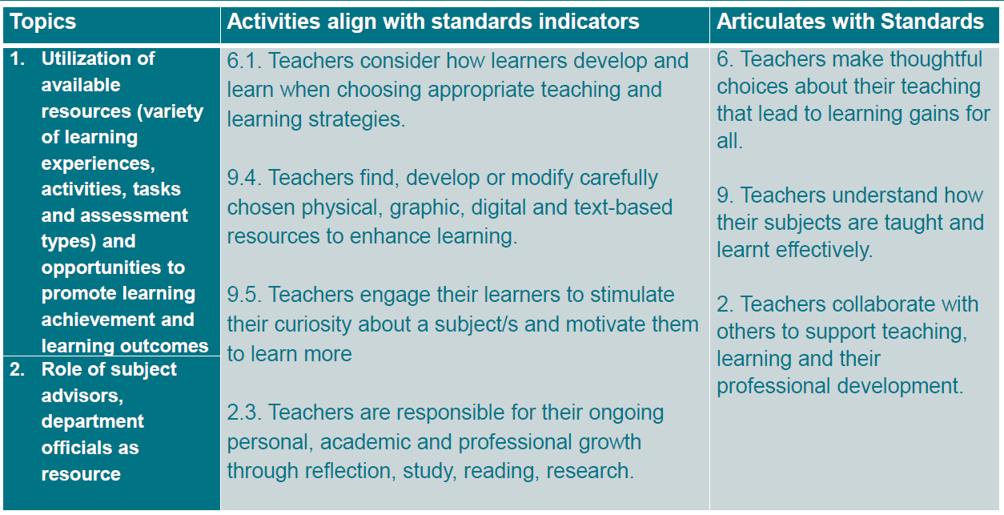
THEME SIX : RESOURCES – PTS 8

Slide 32
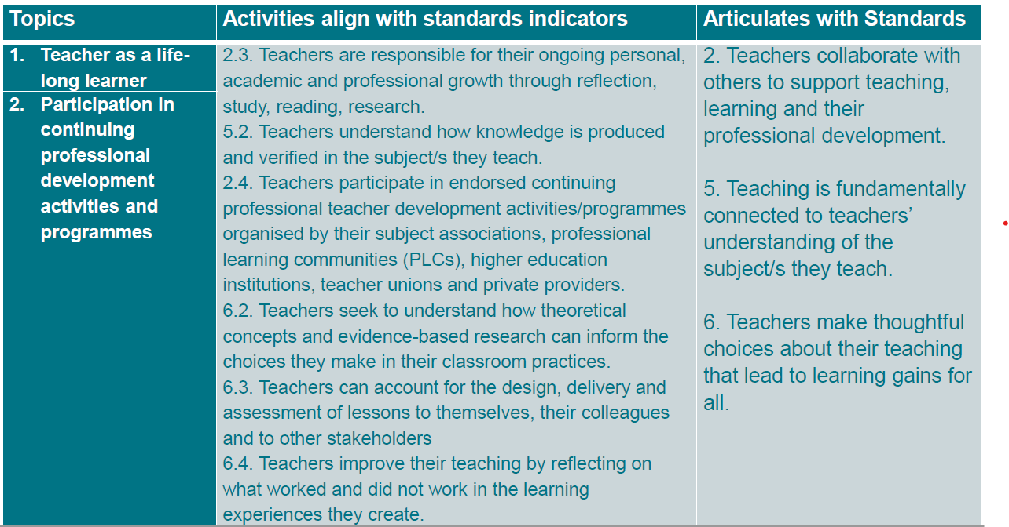
THEME SEVEN: TEACHER AS A CRITICAL, REFLECTIVE PRACTITIONER AND RESEACHER

Slide 33
CONCLUSION
“After the first year, a teacher should have plenty to reflect and grow on because it’s just that, the first year. Each year will get better and better as risks are taken, mistakes are made, and plans fail. New teachers need to know that we don’t learn from success, we learn from the things that don’t go as well as we hoped. That’s when we know what doesn’t work and can grow from there” Anonymous

Slide 34
Drafting of Policy of school-based Work Integrated Learning and Teaching Practice

Slide 35
Drafting of Policy for school based work integrated learning and Teaching Practice
Current Practice
  No policy from National or PEDs
  Unstructured and uncoordinated support by schools
What is done
  Drafting of policy to provide common standards
  RTIA – EU funded programme provided Technical Assistance to draft policy
  HAMK university from Finland was appointed
  First consultation was done last year which informed TORs
  Second consultation was done in March 2026 which informed the survey and focus group questions
  Third consultation is now in May 2026
  Surveys will be issued to school principals to complete – this will assist in gathering facts on what works and what is not working, for consideration on policy
  A survey will also be issued for student teachers to complete the survey for the information to be used when drafting the policy
  The next engagement will be on 30 August to 4 September when the draft policy will be presented

Slide 36




The Strategic Role of Principals
in Teaching Practice and Work Integrated Learning
KEY ROLES
LEADERSHIP
SLIDE 1
School Principals as Instructional & Professional Leaders
Create a supportive environment for student teachers
Ensure proper placement and orientation
Identify and support capable mentor teachers
Promote professional conduct and ethical practice
Align school practices with curriculum expectations
Facilitate school–university–district collaboration
Strengthen teacher preparation
Build professional learning cultures
Ensure quality mentoring & supervision
Improve readiness for classroom realities
Teaching Practice & Work-Integrated Learning
WHY IT MATTERS
Quality school leadership directly shapes the quality of mentoring, teaching practice experiences, and the future educators entering the system.
WIL: Work-Integrated Learning | School Principals as Agents of Quality Teacher Development

Slide 37




Strengthening Quality Teacher Production through Effective Teaching Practice and WIL
TEACHING PRACTICE FOUNDATION
PRINCIPAL'S CONTRIBUTION
LONG-TERM SYSTEM IMPACT
Translate theory into classroom practice
Develop curriculum delivery skills
Strengthen classroom management
Improve learner assessment practices
Build confidence & professional identity
Prepare Classroom ready teachers
Identify Mentors within the school that will work with student teachers
Student Teachers are received
Assign Mentor/s to student teachers
Structured support & feedback for student teachers
Organised and monitored mentoring
Meaningful teaching & learning experiences
Exposure to positive school culture & professionalism
Better prepared newly qualified teachers
Improved teacher retention
Stronger curriculum implementation
Improved learner outcomes
Enhanced professionalism in teaching
"Quality schools contribute to the production of quality teachers, and quality teachers contribute to quality education."

Slide 38




Building Sustainable School–University Partnerships
for Future Quality Education
Schools as Professional Learning Sites
Strengthening Collaboration
Recognised not only as centres of learner education, but as training spaces for future teachers, centres for professional development, and partners in strengthening the national education system.
Principals work collaboratively with universities, district offices, mentor teachers and professional support structures across placement coordination, mentor identification, monitoring, and quality assurance.
Strategic Direction
Expected Outcomes
Formal recognition of schools as professional learning sites · Strengthened principal leadership in WIL · Structured mentorship and induction systems · Ongoing school–university partnerships.
A stronger, more professional and future-ready teaching workforce capable of improving the quality of education — with better teacher preparedness, sustained instructional leadership, and improved learner performance.
A sustainable pipeline of competent educators for improved learner performance and educational outcomes in South Africa.

Slide 39


