Slide 1

REQUEST FOR INPUTS & COMMENTS ON THE NEW DRAFT HISTORY CURRICULUM GRADES 4-12
08/05/2026

Slide 2
PURPOSE
To request SAPA members to assist in mobilizing schools for inputs on the new draft History CAPS documents Grades 4 -12.

Slide 3
INTRODUCTION
During the fifth administration, the Minister of Basic Education appointed a Ministerial Task Team (MTT) to review the History curriculum.
The terms of reference were as follow:
  To develop a new History curriculum from Grades 4-12;
  To conduct provincial consultations in the education sector to obtain inputs into the new History Curriculum;
  To receive public inputs and comments for consideration on the new History curriculum;
  To screen new textbooks to ensure alignment with the new curriculum; and
  To propose History Teacher development programmes for both Initial Teacher Education and In-Service Teacher Education (re-skilling and up-skilling).

Slide 4
Members of the History MTT
NAME | INSTITUTION
Professor Sifiso Ndlovu (Chairperson) | South African Democracy Education Trust and UNISA
2. Professor Peter Sekibakiba Lekgoathi | History lecturer at Witwatersrand University
3. Professor Amanda Esterhuysen | Archaeology lecturer at University of Cape Town
4. Mr Jabulani Sithole | Commission for Traditional Leadership for Disputes and Claims
5. Professor Nomalanga Mkhize | History Lecturer at Nelson Mandela University.
6. Dr Kate Angier | History Lecturer at School of Education, University of Cape Town.
7. Dr Suren Seetal (replaced Dr Callinicos) | KZN Department of Education, History External Moderator at Umalusi for both DBE and IEB.
4

Slide 5
Draft Curriculum Framework
Historiography
Archaeology
(Material culture)
African history
Heritage & local history
Labour History
Language
Gender & culture history
Archives

Slide 6
Curriculum Overview - Grades 4-9
The curriculum is intended to:
Build skills and concepts horizontally and vertically
Create an awareness of the range of available sources:
    an appreciation for sources in mother tongue
    use of technology to discover new information
Introduction to objects : archaeology as a source
internal development of precolonial African society/ innovation
Encourage the exploration of a complex and nuanced pre-colonial past
6

Slide 7
Curriculum Overview : Grades 10-12
In the FET (Grades 10-12) the curriculum is intended to:
Re-introduce key concepts in historical evidence, with a special focus on oral traditions as a global human archival practice.
Re-introduces pre-colonial epochs with a greater degree of depth and complexity of narrative.
Developing a critical perspective and analytical approach to how and why forms of history are constructed.
Instilling a global and continental African-centred historical consciousness.
7

Slide 8
Curriculum Overview : Grade 10-12
The introduction of oral traditions and folklore as elements of history (e.g. diboko, izithakazelo)
Introduction to objects, material culture, physical evidence, and change over time (archaeology)
Introducing internal development of precolonial African society (pre-colonial innovation)
Introducing comparative world history
8

Slide 9
Curriculum Overview
Archaeology and Palaeontology (use of Material Culture, Carbon dating, dendrochronology and other scientific methods in African history etc.);
Focus on Depth Studies (and World History/Global History moving away from the parochial, Eurocentric and Cape-centric history of South Africa);
Instilling within the learners a global and continental African-centred historical consciousness, i.e. building global citizens;
Using a mixed studies approach (mixing both Chronology and Thematic approach)
9

Slide 10
REQUEST FOR INPUTS & COMMENTS ON THE DRAFT HISTORY CURRICULUM
MTT managed to complete the draft History Curriculum Grades 4 – 12 and is now made available for public comments.
Minister approved the submission to gazette for public comments:
  A gazette for comments was released on 20 March – 20 April 2026.
  Some public members requested for extension and the Minister approved.
  A gazette for extension was released on 30 April – 30 May 2026.
The three new draft History CAPS documents have been packaged and uploaded on the DBE Website as follows:
  Grades 4 – 6
  Grades 7 – 9
  Grades 10 – 12
  Template for comments

Slide 11

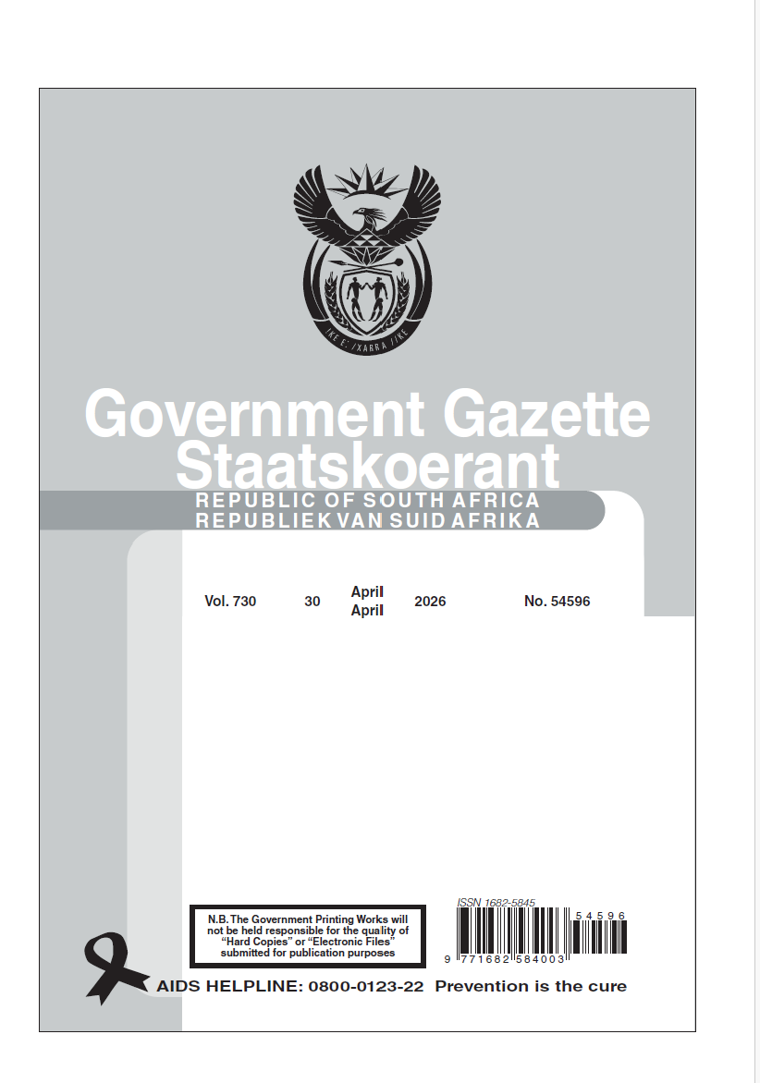
GAZETTES

Slide 12
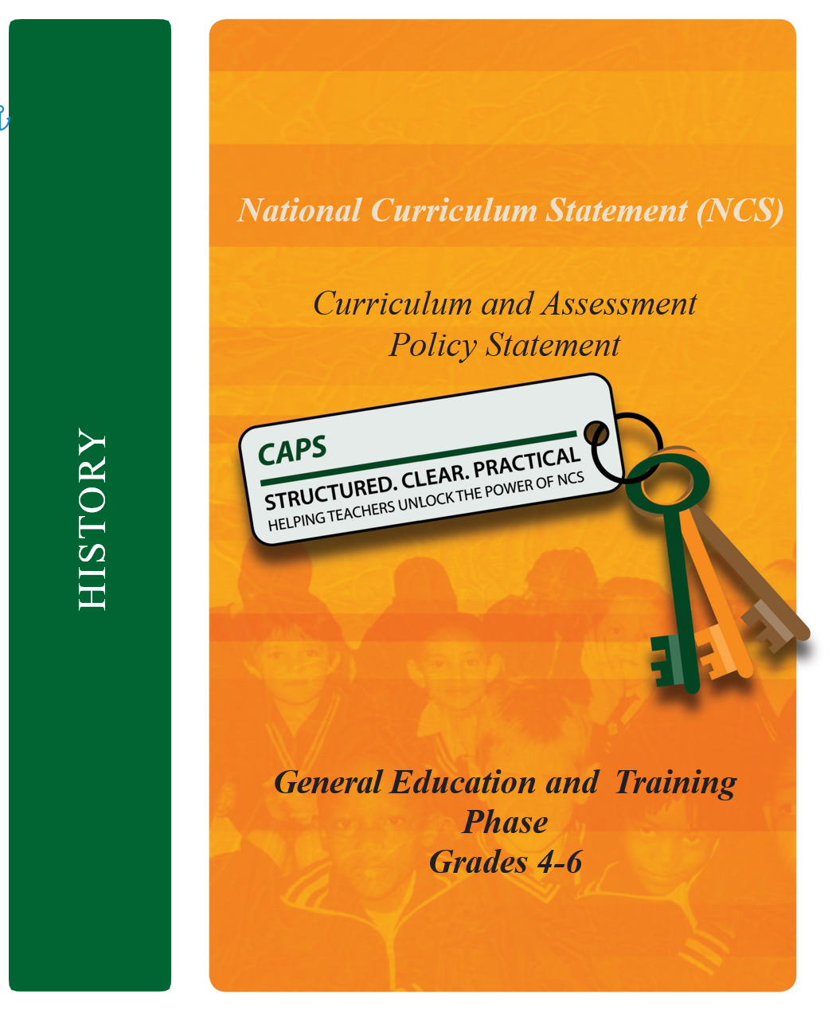
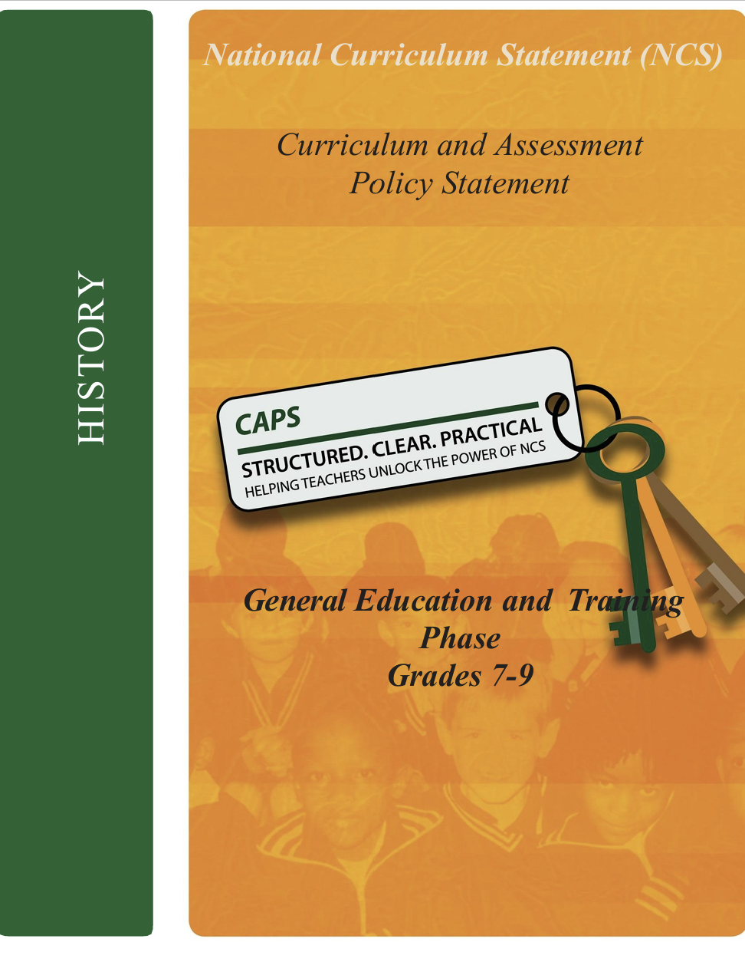
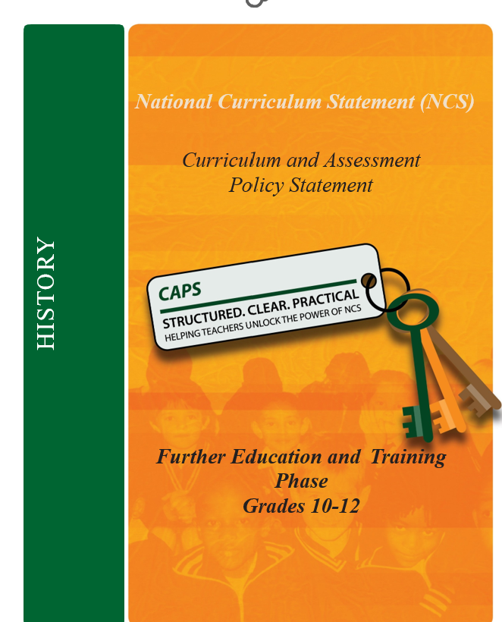
NEW DRAFT HISTORY CAPS DOCUMENTS

Slide 13
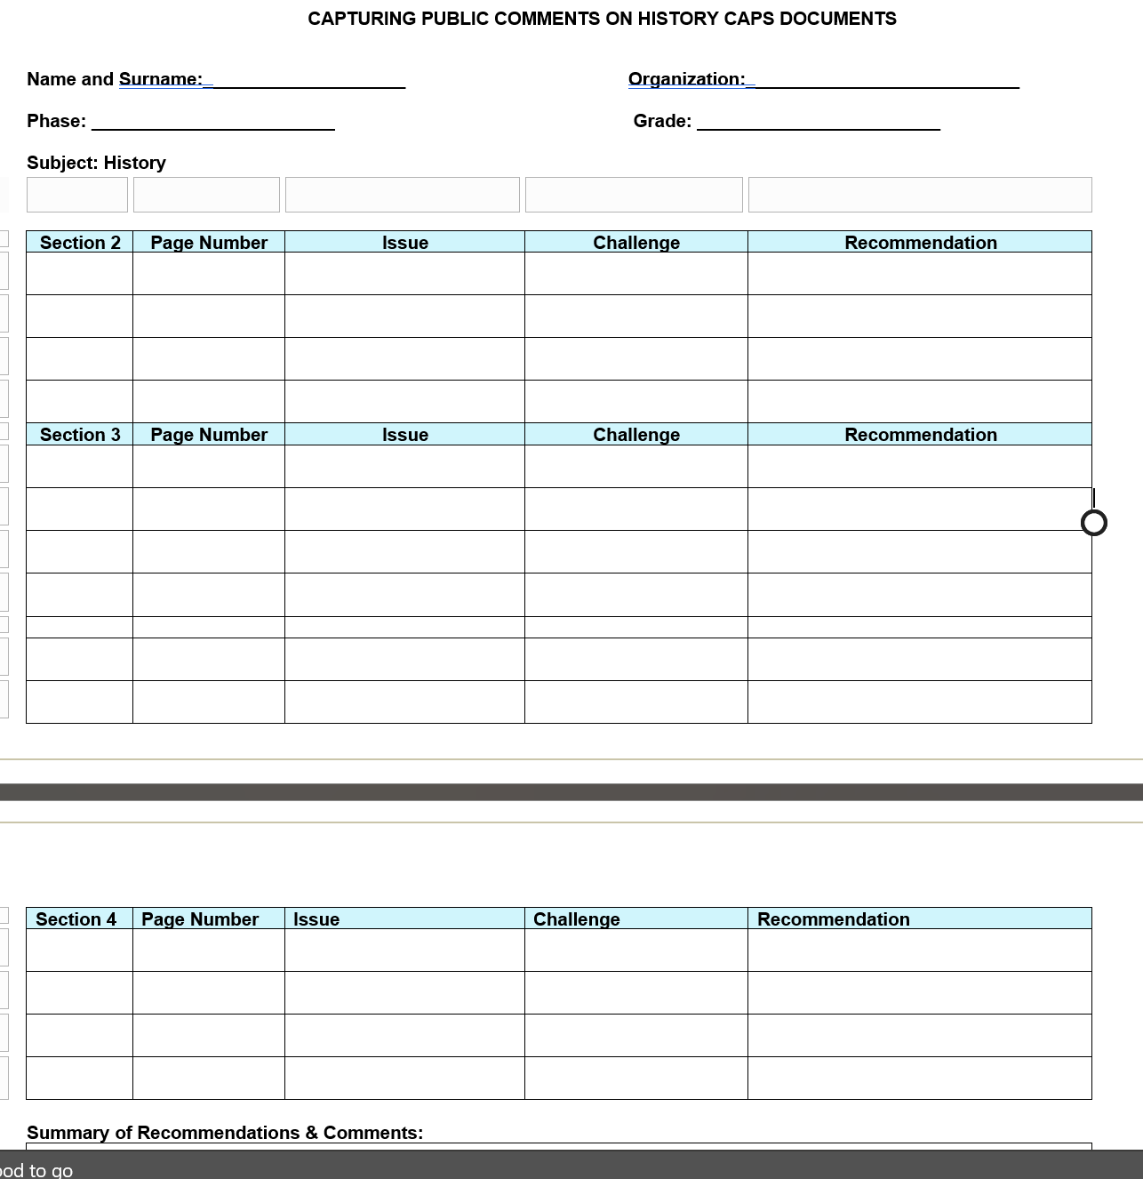
TEMPLATE FOR INPUTS & COMMENTS

Slide 14
DBE WEBSITE LINK
https://www.education.gov.za/ArchivedDocuments/ArchivedArticles/CallforcommentsHistoryCaps.aspx
Comments to be sent to: Ms Florence Modipa
Email address: Modipa.F@dbe.gov.za

Slide 15
CONCLUSION
It is envisaged that through this process the DBE will:
  reach wider audience
  receive valuable and nuanced inputs to strengthen the new draft History CAPS documents.

