Slide 1

SOUTH AFRICAN PRINCIPALS’ASSOCIATION MEETING
The role of SAPA in strengthening school leadership capacity for the implementation of Inclusive Education Practices
15 May 2026
Ms. SA Mhlongo

Slide 2
PRESENTATION OUTLINE
Purpose of the Presentation.
Introduction.
The 7th administration key priorities for DBE
Paradigm Shift.
Why Inclusive Education Matters?
Equity vs Equality.
Policy and Legislative Framework
What should be done to drive inclusion?
8.1 Strengthening SMT Leadership for Inclusive Education.
8.2 Enhancing SGB Governance Roles in Inclusive Education.

Slide 3
PRESENTATION OUTLINE
8.3 Why this matter for SGB and SMT?
8.4 What are we not doing today?
8.5 How schools must be managed and governed?
8.6 Governance and management decisions that matter most.
8.7 Budgeting through an Equity Lens
8.8 Persistent Challenges
8.9. Call to Action
9. DBE Interventions
10. Recommendation

Slide 4
PURPOSE OF PRESENTATION
The purpose of this presentation is to highlight the role of SAPA in:
Strengthening the school leadership capacity for the implementation of inclusive education practices in schools;
Strengthening School Governing Bodies’ and School Management Team’s understanding of their governance and management roles in supporting learners with barriers to learning and development, including those with disabilities;
Highlighting how governance and management decisions affect access, dignity and quality of education;
Promoting effective collaboration between schools, parents and support services; and
Equipping SGBs and SMTs to make informed, equitable and lawful decisions that enable effective school governance and management.

Slide 5
POLICIES AND LEGISLATIVE FRAMEWOK
This presentation emphasises the importance of the alignment with International, National legislative and policy frameworks such as:
Constitution of South Africa Act 108 of 1996 – Section 29(1)(a);
Education White Paper 6 (2001);
Policy on Screening Identification Assessment and Support (2014);
South African Schools Act 84 of 1996 as amended;
United Nations Convention on the Rights of Persons with Disabilities (UNCRPD 2007),
Basic Education Laws Amendment Act 32 of 2024,
National Development Plan, UNESCO Education Agenda 2030 (SDG 4); and
Action Plan to 2024: Towards the realisation of Schooling 2030 ensuring that school-level decisions support equity, access, and redress.

Slide 6
INTRODUCTION
The mandate of the Basic Education sector is to provide an environment where everyone will have access to lifelong learning, education and learning opportunities.
Access to these opportunities is thus an institutional imperative that must be actualised in order to enable all citizens to improve the quality of their lives and to be able to contribute meaningfully to the welfare of their communities and society in general.
Inclusive education offers a mechanism through which the sector can achieve the long-lasting, vastly better development prospects for all children, especially those with disabilities.
Significant progress has been made in ensuring that children with disabilities can enjoy uninhibited access to the right to a basic education.
However, challenges prevail in ensuring access for all children, especially those with disabilities.

Slide 7
THE 7TH ADMINISTRATION’S KEY PRIORITIES FOR BASIC EDUCATION
Early Childhood Development (ECD);
Literacy, Numeracy, and Mother Tongue-Based Bilingual Education;
Inclusive Education, Health Promotion, and Social Cohesion;
Improving curriculum delivery, and
Infrastructure Delivery, Learner Transport and School Safety.

Slide 8
PARADIGM SHIFT
SPECIAL EDUCATION
INCLUSIVE EDUCATION
MEDICAL MODEL
SOCIAL MODEL
SPECIAL SCHOOLS
FULL-SERVICE SCHOOLS
ORDINARY PUBLIC SCHOOLS
SCHOOL
SEGREGATION
INCLUSION
FIXING THE CHILD
FIXING THE SYSTEM

Slide 9
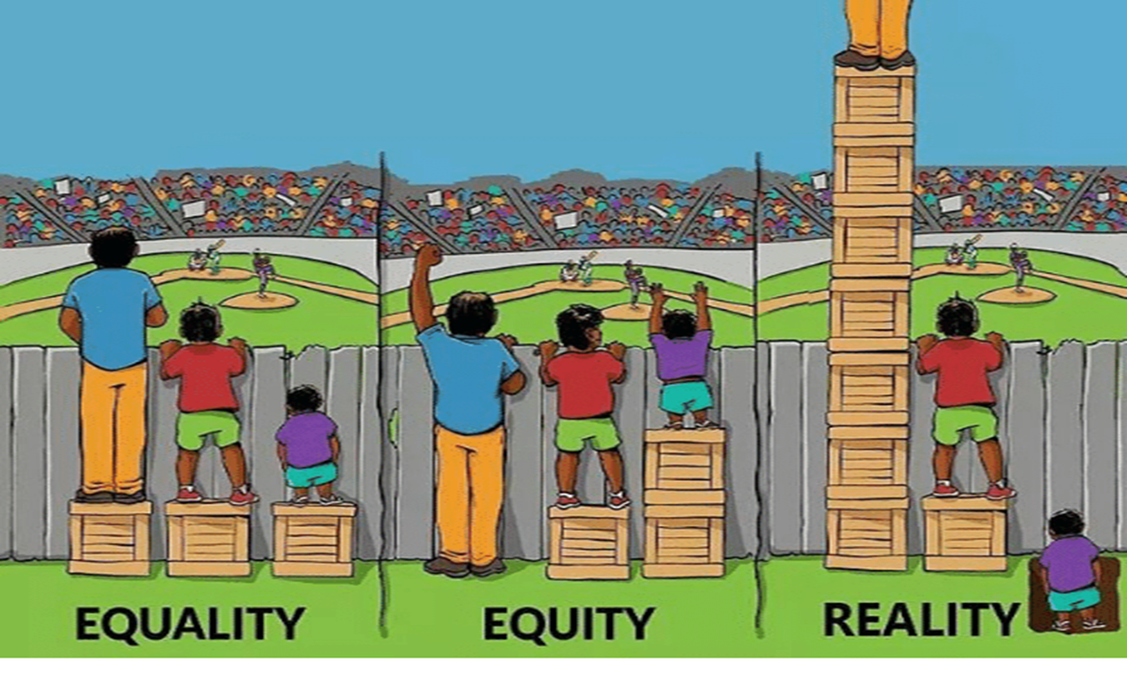
EQUITY VS EQUALITY
Equality is about giving people the same thing, irrespective of their circumstances, while equity is about ensuring fairness in every situation.
Notes:
Equality is about giving people the same thing, irrespective of their circumstances, while equity is about ensuring fairness in every situation.

Slide 10
WHY INCLUSIVE EDUCATION MATTERS?
Inclusive education is not just policy — it's a moral and constitutional duty.
It is rooted in South Africa’s fight against inequality, and exclusion.
It aims to break down systemic barriers and uphold the principles of equity, dignity, and justice for every learner.
Inclusive education means ensuring every learner feels a sense of belonging, can actively participate, and receives the support they need.
Teaching methods, curricula, infrastructure, and attitudes must embrace diversity — enabling all children to thrive, regardless of background or ability.

Slide 11
WHY INCLUSIVE EDUCATION MATTERS?
Education White Paper 6 directs on how the country must go about building a single, inclusive system of education and training, by designation and conversion of 500 ordinary public schools to full-service schools.
By the end of 2018, PEDs had already designated 848 FSSs, which has exceeded the sector’s target.
The Auditor-General’s finding in 2018 was that most designated FSSs were not functioning effectively.
DBE: Inclusive Education Directorate also realised that FSSs are becoming a watered-down version of special schools, which is creating a dual system of education.
How can we have a system that is generating both? (Inclusion and exclusion)
What can we discourage it to stop generating exclusion? (Our decisions, what we do, our practices, how we distribute resources, how we understand support, how we monitor, and what we monitor)

Slide 12
ALIGNMENT WITH NATIONAL & INTERNATIONAL POLICIES AND LEGAL FRAMEWORK
  Strong understanding of national policies ensures effective school-level inclusive education implementation (policy alignment).
  School managers and governing bodies identify barriers, establish support teams, and oversee inclusive education practices (management and governance roles).
  Policies like SIAS and South African Schools Act guide screening, support, admissions, and anti-discrimination efforts (operationalise legal frameworks).
  Aligning plans and budgets with national frameworks fosters coherence, accountability, and sustainable inclusive education (ensuring accountability and sustainability).

Slide 13
WHAT SHOULD BE DONE TO DRIVE INCLUSION?
Acknowledge that all children and learners can learn and need support.
Enabling education structures, systems, and learning methodologies to meet the needs of all learners.
Acknowledge and respect differences in learners, whether due to age, gender, ethnicity, language, class, disability, HIV or other infectious diseases.
Changing attitudes, behaviours, teaching methods, curricula, and environment to meet the needs of all learners.
Maximising the participation of all learners in the culture and the curriculum of educational institutions and uncovering and addressing barriers to learning.

Slide 14
STRENGTHENING SMT LEADERSHIP FOR INCLUSIVE EDUCATION
  SMTs are essential in implementing inclusive education policies and fostering a school culture that respects diversity (role of SMT in inclusive education).
  Developing SMT skills in instructional leadership, learner support, data use, and change management is key to effective inclusion (competent leadership).
  SMTs use learner data to identify barriers and evaluate interventions for continuous improvement in inclusive education (evidence-based intervention).
  Ongoing leadership development, mentoring, and professional learning communities help sustain inclusive education practices (sustaining inclusive education system).

Slide 15
ENHANCING SGB GOVERNANCE ROLES IN INCLUSIVE EDUCATION
  SGB members must understand their legal duties and the impact of inclusive education on governance decisions (SGBs legal responsibilities).
  SGBs adopt and review policies ensuring alignment with inclusive principles and human rights values (inclusive policy development).
  Targeted training to equip SGB members on legislation, reasonable accommodation, and non-discriminatory practices (SGBs capacity building).
  Including parents of learners with disabilities and those experiencing barriers enhances representation and ensures diverse perspectives in governance (community and parental involvement).

Slide 16
WHY THIS MATTERS FOR SMTS AND SGBS
Learners with disabilities and those with barriers to learning and development are part of our schools.
SMTs and SGBs make decisions that directly affect their access to education and learning.
Weak management and governance impacts the most vulnerable learners first.
Strong management and governance makes schools welcoming for everyone: learners, parents and guardians, teachers, support staff, and partners.

Slide 17
WHAT WE ARE NOT DOING TODAY
Key points:
  ❌ Medical or clinical training.
  ❌ Diagnosing learners.
  ❌ Turning SMTs and SGBs into health specialists.
What we ARE doing:
  ✔ Understanding management and governance implications.
  ✔ Strengthening management and governance oversight and decision-making.
  ✔ Supporting school leadership effectively.

Slide 18
HOW SCHOOLS MUST BE MANAGED AND GOVERNED?
Standard school systems are often not enough.
Decisions must prioritise:
  Safety,
  Care,
  Support,
  Dignity,
  Release of potential, and
  Active participation in life.
Management and Governance must be intentional and informed.

Slide 19
GOVERNANCE AND MANAGEMENT DECISIONS THAT MATTER MOST
Key areas under SMT and SGB oversight:
  Creating an Inclusive School Environment
  Curriculum adaptation and support
  Policy Implementation and Leadership
  Budgeting and resource allocation.
  Staff Capacity building
  School policies (admissions, safety, discipline).
  Staffing and support structures.
  Infrastructure and accessibility.
  Parent and community engagement.

Slide 20
BUDGETING THROUGH AN EQUITY LENS
Equity ≠ equality.
Learners with barriers to learning need more support — and that is justified.
Budget decisions should consider:
  learner support materials.
  assistive devices and technologies.
  care and safety needs.
  staff support and training (training of teachers in inclusive education).
  Staff wellbeing affects learner wellbeing: How teachers and support staff feel, cope, and are supported directly influences how well learners are cared for, taught and protected.

Slide 21
PERSISTENT CHALLENGES
Misalignments in conceptualisation and implementation – persistence of special education despite the adoption of inclusive education.
Children of compulsory age still out of school, especially those with disabilities in community-based special care centres.
Weak early identification, prevention and intervention systems.
Limited access to inclusive education in ordinary public schools for learners with disabilities.

Slide 22
ALL MUST MEAN ALL

Slide 23
CALL TO ACTION
SMT and SGB should assess their school’s state of inclusive education.
Allocation of budget and resources to support inclusive education
Commit to ongoing professional development of staff members.
Set up systems for early identification, prevention, and intervention in schools (using relevant policies and laws)
Build trust and open communication with parents.
Stakeholders’ Engagement at the school level is key.
Partner with local organisations and specialists.
Work with Special Schools/Special Schools Resource Centres (SSRC) in their area.
Reviewing school policies and aligning with national and international obligations.

Slide 24

DBE KEY INTERVENTIONS
Deepening intradepartmental and intersectoral collaboration (health, social development).
Strengthening engagements with principals/School Management Teams (SMTs), School Governing Bodies (SGBs), civil society organisations, including organisations representing persons with disabilities.
Mobilisation and placement of out-of-school children, especially those with disabilities.
Strengthening early identification, intervention, and prevention in PEDs, using policies and laws.
Training of teachers in specialised areas of inclusive education.
Prioritising early childhood development and early identification, prevention, and intervention.

Slide 25
RECOMMENDATION
It is recommended that the South African Principals Association Meeting consider the presentation: ”The role of SAPA in strengthening school leadership capacity for the implementation of Inclusive Education Practices”, for noting and discussion.

Slide 26


